Slide 1
METABOLIC DISORDERS-I
CARBOHYDRATES
R.M., SRSV

Slide 2
INTRODUCTION
Carbohydrates are major fuels of the tissues, important energy stores and metabolic intermediates. If there is any defect in carbohydrate metabolism, there will be clinical consequences and may even lead to death.
Inborn error may occur in metabolism of all biomolecules. Errors occur due to metabolic enzymes may be absent or deficient.
The defective enzyme occurs due to mutation in coding of gene.
Absent enzyme: If the enzyme is totally inactive or absent, the reaction will not occur.
Deficient enzyme: If the enzyme activity is decreased or altered, the reaction velocity will decrease.
When an enzyme of a carbohydrate metabolic pathway is absent or deficient, the entire pathway become abnormal.

Slide 3
INTRODUCTION
Inborn Errors of Carbohydrate Metabolisms are:
Galactosaemia
Glycogen storage diseases
Gluconeogenesis disorders
Pyruvate carboxylase deficiency
Fructose-1,6-bisphophatase deficiency
Hereditary fructose intolerance
Glucose-6-phosphate dehydrogenase deficiency
Diabetes mellitus
OGTT

Slide 4
Galactosaemia
Lactose from milk is hydrolysed by intestinal lactase to produce glucose and galactose.
Classical Galactosaemia:
i) Galactose-1-phosphate uridyltransferase deficiency: There is accumulation of galactose-1-phosphate and galactose and secondary formation of galactitol. It typically presents by the end of the first week of life with poor feeding, vomiting, lethargy, jaundice, hepatomegaly, neonatal cataracts and renal tubular disease and is often associated with E. coli septicaemia.
Biochemically there may be hyper-bilirubinaemia, raised alanine aminotransferase (ALT), generally elevated plasma and urine amino acids, albuminuria, glycosuria and galactosuria.

Slide 5
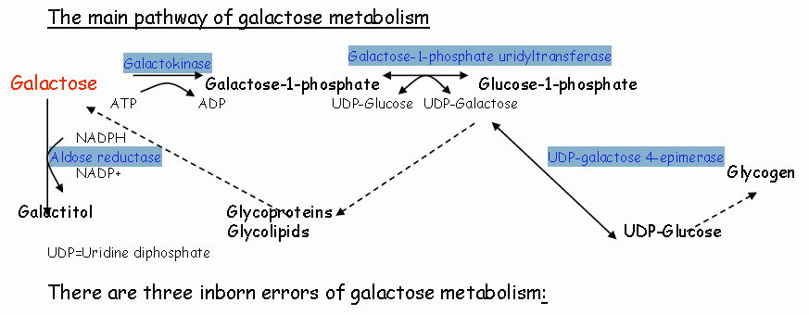
Galactosaemia

Slide 6
Galactosaemia
ii) Galactokinase Deficiency: This is a rare disorder where there is an inability to phosphorylate galactose and galactose and galactitol are excreted in urine Neonatal (but not congenital) cataracts occur-often bilateral due to the accumulation of galactitol in the lens.
iii) UDP-galactose 4-epimerase deficiency:
Mild form, A partial enzyme deficiency due to reduced protein stability and more pronounced in cells with long lifespan e.g. erythrocytes.
Normal growth and development. No treatment appears necessary.

Slide 7
Glycogen Storage Diseases
The brain, red blood cells, and inner portion of the adrenal gland (adrenal medulla) depend on a constant supply of glucose for their metabolic functions. This supply begins in the small intestine, where transport proteins mediate the uptake of glucose into cells lining the gut. Glucose subsequently passes into the bloodstream and then the liver, where it is stored as glycogen. In times of starvation or fasting or when the body requires a sudden energy supply, glycogen is broken down into glucose, which is then released into the blood. Muscle tissue also has its own glycogen stores, which may be degraded during exercise. If enzymes responsible for glycogen degradation are blocked so that glycogen remains in the liver or muscle, a number of conditions known as glycogen storage disorders (GSD). Depending upon which enzyme is affected, these conditions may affect the liver, muscles, or both.

Slide 8
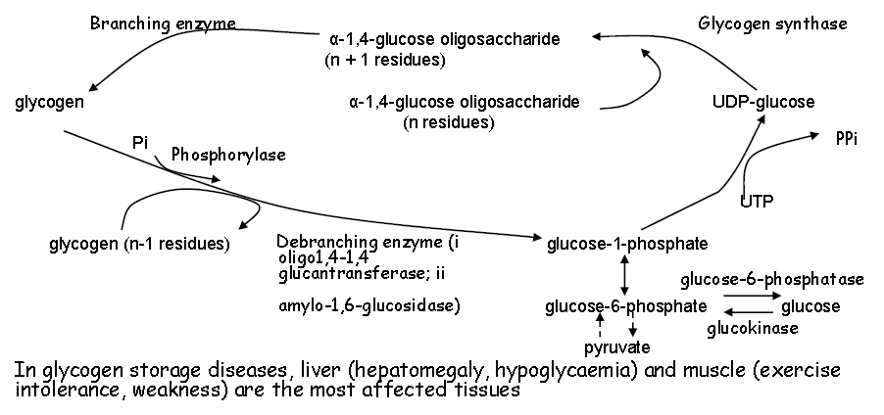
Glycogen Storage Diseases

Slide 9
Glycogen Storage Diseases
GSD I accounts for approximately 25% of GSD cases
Glucose-6-phosphatase deficiency (GSD Ia): is a defect in the release of glucose from glucose-6-phosphate and affects both glycogenolysis and gluconeogenesis.
It presents with hepatomegaly, short stature and truncal obesity.
Biochemically there is hypoglycaemia, lactic acidaemia, hyper-uricaemia and hyperlipidaemia.
Histological analysis shows excess of fat and glycogen in hepatocytes.
GSD Ib is a defect in a transporter protein: has the same features GSD Ia plus neutropenia, recurrent bacterial infections and inflammatory bowel disease.

Slide 10
Glycogen Storage Diseases
GSD II:
Enzyme defect: Lysosomal α1,4-glucosidase
Most affected Diagnostic tests Sample tissue(s): Generalised; Enzyme assay accumulation of glycogen in lysosomes
Clinical Features: Infantile form: cardiomegaly, hypotonia, Juvenile & adult form: skeletal myopathy
GSD III:
Enzyme defect: Debranching enzyme
Most affected Diagnostic tests Sample tissue(s): Liver & muscle (IIIa), liver only (IIIb); storage of large amount of abnormal glycogen with short outer branches
Clinical Features: Hepatomegaly, hypoglycaemia, hyperlipidaemia, growth retardation, muscle weakness

Slide 11
Glycogen Storage Diseases
GSD IV:
Enzyme defect: Branching enzyme
Most affected Diagnostic tests Sample tissue(s): Liver; accumulation of glycogen with fewer branch points and longer chains (poor solubility)
Clinical Features: Hepatosplenomegaly, failure to thrive, liver cirrhosis
GSD V:
Enzyme defect: Muscle phosphorylase
Most affected Diagnostic tests Sample tissue(s): Muscle; Increased amount of glycogen (normal structure)
Clinical Features: Exercise intolerance with muscle cramps

Slide 12
Glycogen Storage Diseases
GSD VI:
Enzyme defect: Liver phosphorylase
Most affected Diagnostic tests Sample tissue(s): Liver; Increased amount of glycogen (normal structure)
Clinical Features: Hepatomegaly, growth retardation, mild tendency to hypoglycaemia, mild hyperlipidaemia
GSD VII:
Enzyme defect : Phosphofructo kinase
Most affected Diagnostic tests Sample tissue(s): Muscle, erythrocytes (excess glucose leads to increased formation of glycogen)
Clinical Features: Exercise intolerance, haemolytic anaemia

Slide 13
Glycogen Storage Diseases
GSD IX:
Enzyme defect: Phosphorylase b kinase (defect in one of 4 subunits)
Most affected Diagnostic tests Sample tissue(s): Liver and/or muscle
Clinical Features: As for GSD VI (functional deficiency of phosphorylase)

Slide 14
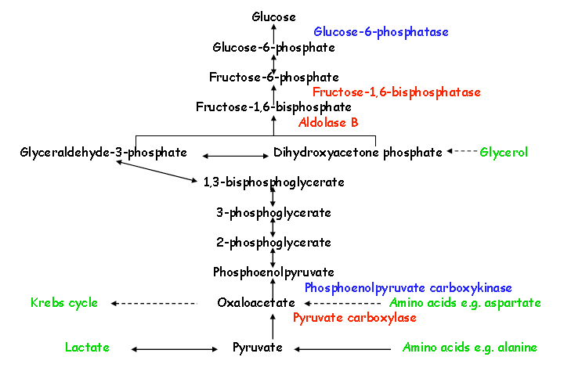
Disorders of Gluconeogenesis

Slide 15
Disorders of Gluconeogenesis
Pyruvate Carboxylase Deficiency:
This presents with lactic acidosis, neurological dysfunction (seizures, hypotonia, coma)
It is a defect in the first step of gluconeogenesis which is the production of oxaloacetate from pyruvate. In addition to the effect on gluconeogenesis, lack of oxaloacetate affects the function of the Krebs cycle and the synthesis of aspartate (required for urea cycle function).
In the acute neonatal form the lactic acidosis is severe, there is moderately raised plasma ammonia, citrulline (& alanine, lysine, proline) and ketones. Fasting results in hypoglycaemia with a worsening lactic acidosis.

Slide 16
Disorders of Gluconeogenesis
Fructose-1,6-Bisphosphatase Deficiency:
This presents with moderate hepatomegaly, metabolic acidosis (lactate & usually ketones) and hypoglycaemia.
The defect leads to impaired gluconeogenesis and accumulation of precursors of gluconeogenesis: lactate, pyruvate, alanine, ketones. The only glucose source is dietary or via glycogenolysis. The latter may be a problem in neonates as they usually have low glycogen stores.
Acute episodes may be precipitated by fasting or infection

Slide 17
Hereditary Fructose Intolerance-(HFI)
A defect in fructose metabolism (deficiency of aldolase B), only presents after ingestion of foods containing fructose, sucrose or sorbitol. When an infant with HFI is weaned, they suffer from nausea, vomiting, gastrointestinal discomfort and lethargy. They are at risk of liver and kidney failure and death, if fructose is not withdrawn.
Affected individuals may reach adulthood undiagnosed due to development of an aversion to fructose containing foods. Around 50% of adults with HFI have no dental caries, so occasionally the diagnosis has been made by dentists.
Biochemical features include hypoglycaemia (accumulated fructose-1-phosphate inhibits glucose production), hypo-phosphataemia, elevated plasma lactate, positive urine reducing substances, hyper-uricaemia and a generalised aminoaciduria.

Slide 18
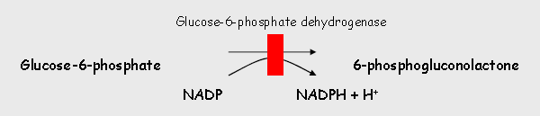
Glucose-6-phosphate dehydrogenase deficiency
This is an X-linked defect in the first, irreversible step of the pentose phosphate pathway.
A decrease in NADPH production makes red bloods cell membranes vulnerable to oxidative stress, leading to haemolysis.
The most common manifestations are early neonatal unconjugated jaundice and acute haemolytic anaemia. However most individuals with the deficiency are clinically asymptomatic. The haemolytic crises are usually in response to an exogenous trigger such as certain drugs (e.g. antimalarials), food (broad beans) or an infection.

Slide 19
Diabetes mellitus
Diabetes mellitus is associated with several metabolic alterations. Most important among them are Hyperglycaemia, Ketoacidosis, Hypertriglyceridemia. Atherosclerosis, Retinopathy, Nephropathy , Neuropathy.
Dietary management: Low calorie , High protein and fiber rich diet, reduce fat intake,exercise.
Hypoglycemic drugs: Sulfonylureas and Biguanides, Insulin: Short acting ( for 6 hours) and Long acting (for several hours).
Types: IDDM and NIDDM
Type 1 Diabetes – Juvenile onset diabetes
Type 2 diabetes- Adult onset diabetes

Slide 20
Diabetes mellitus
Type 1 Diabetes(IDDM): – (Juvenile onset diabetes) Occurs in childhood, 10-20% of diabetic population, characterized by almost total deficiency of insulin, due to destruction of Beta cells of Pancreas. Symptoms appear after 80-90% of Beta cells have been destroyed. Pancreas fails to secrete insulin in response to food ingestion. Therefore, patient require insulin therapy.
Type 2 diabetes(NIDDM):- (Adult onset diabetes) Most common, 80-90% of diabetic population, Occurs in adults. Commonly occurs in obese individuals. Decreasing insulin receptors on insulin responsive cells.

Slide 21
Diabetes mellitus-OGTT
Oral glucose tolerance test (OGTT):
Take carbohydrate for at least 3 days prior to test. All drugs influencing carbohydrate metabolism should be discontinued. Avoid strenuous exercise on days previous to test. Be in overnight fasting state.
Conducted preferably in morning (9-11 am), Fasting blood sample is drawn and urine collected. Subject given 75g glucose orally, dissolved in 300mL of water, to be drunk in 5 min. Blood and urine samples collected at 30 minute intervals for at least 2 hours. Glucose estimation of all blood samples. Urine sample qualitatively tested for glucose.
Fasting plasma glucose level = 75-110mg/dL in normal person. Persons-> impaired glucose tolerance -> fasting (110-126mg/dL) and 2 hour (140-200mg/dL) plasma glucose levels are elevated.

Slide 22
…CONTINUOUS LEARNING…
THANKS

